Slide 1
iPark: Intelligent Parking
Members: Guide:
Kushagra (2000271530029) Mr. Samender Singh
Abhinav Sajjan (2000271530006)
Himanshu Mishra (2000271530024)
Shreyashi Jaiswal (2000271530056)
Notes:
/* [KUSHAGRA]
Hello all panel members, a very good morning to you all I am Kushagra and I am here with my group members to present our project iPark, It is an intelligent parking system that will have the capability to park a car into a tight space in a virtual simulation. */

Slide 2
Project VIVA Presentation
Notes:
/* [KUSHAGRA]
First of all the questions arises why should I or anyone be worried about parking?
I will tell you a little background story about it, so the last month there was a rainy day and me and my father has an understanding that if it’s raining then I will take the car to college and it was all fine but when I reached college I entered the parking lot and I noticed that there are no wide spaces available and the guard was keen to have me parked in a space between 2 cars, now I believe that I am a capable driver and I was able to park there but it got me thinking why should I bear all the tension of parking in a tight space and then getting out of car without dinking the adjacent ones (we all have been there), why don’t we have a system that can do that parking task for us, you might say there exists fully functional driving systems like Tesla which can park for you, but it is expensive and I love to drive my car, I just want a parking system, coincidentally us group members were also thinking about finalising a final year project and with this scenario and need in mind we come up with the idea of creating a Reinforcement Learning model which can do this task for us in a simulated environment. */

Slide 3
Outline
Introduction
Tools and Technology Utilised
System Overview & Architecture
Results
Conclusion
Demonstration
Contents of the presentation
Notes:
[KUSHAGRA]
This presentation presents these points about the project, Introduction where we will see the significance of this project and the objectives, system overview which will discuss about the scopes and features, then functional and non-functional requirements and then closing it with use cases and system architecture.

Slide 4
Introduction
Notes:
[KUSHAGRA]
These are the subsections under Introduction

Slide 5
Introduction
Project Goal: Develop an autonomous parking system using Reinforcement Learning (RL) within a Unity simulation environment.
Background: The rapid development in AI and ML technologies has significant applications in the automotive industry, especially in autonomous driving and parking.
Identification of the Problem:
Traditional parking methods are time-consuming and inefficient.
Increasing urbanization demands better parking solutions.
Notes:
[KUSHAGRA]
Lets talk a bit about the background of the problem and the tech,
Machine learning revolutionizes tasks and we all understand what that means, whether its weather forecasting or stock trends or even things such as monthly expenditure, we can monitor and predict all of these with simple machine learning techniques and that is the strong point of machine learning, RL on the other hand is a bit more advanced technology where we implement machine learning with real world scenarios and training based on experience of the model, the model plays the scenarios and learn by its mistakes.
Then there is the car parking challenges that we all face like spatial awareness, trajectory planning and a strong decision making ability, our RL agent should be able to tackle these challenges.
We have decided to implement all of this in a simulated environment hence I must introduce you all to Unity, Unity is a game engine that is used to make games, apart from that it is developed in such a way that it can be used to make almost any computer, web, mobile, or even TV applications, It also has a very realistic simulation environment and physics engine which we will need for the training of the model.
The projects is not only a significant part of our group’s life due to the BTech norms but also a significant contribution to the field of autonomous car driving or parking, it can act as a pre-defined or pre-trained model of anyone’s new adventure and also can be a cost-effective add-on to a car that users can have.

Slide 6
Introduction Contd.
Significance:
Reduces time spent on parking.
Enhances user convenience and traffic flow.
Contributes to the development of fully autonomous vehicles.
Objectives:
Create an RL model capable of autonomous parking.
Implement diverse and realistic parking scenarios in Unity.
Train and evaluate the RL agent's performance.
Provide a scalable solution for real-world applications.
Note: For more details, refer to the report PDF file Chapter 1.
Notes:
[KUSHAGRA]
Lets talk about the actual problems the project faces
The challenges about a parking scenario, as discussed in last slide this is a task capable only for an intelligent mind such as a human brain, some hurdles include real-time decision making, and trajectory planning.
Then comes the complexities of real world scenarios, when we were kids and were learning about cars or driving , it all seemed so easy and so cherry but when it came to actually drive a car it was a challenge, same applied to parking a car, there are different variables like oncoming and ongoing traffic, car bounds and adjacent cars, even a plant pot is an obstacle we avoid while parking.
The first 2 points were just staging the entry of RL and RL is a tech that is specifically designed for real-world applications like these, the RL’s rationale approach is what makes it the most suitable, a traditional algo can never be able to handle these complexities hence we need a robust RL model.
This project serves a very narrow but important purpose in the autonomous parking systems and can be used as a commercial product or a platform for learning or creating new things.

Slide 7
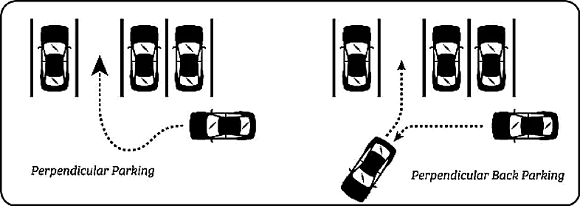

Slide 8
Tools and Technologies Utilised
Notes:
[HIMANSHU]
Hello and good morning all panelists, I am himanshu and I will proceed with the presentation now,
Lets talk about the system overview of our project, it has widely 2 sections: scope and key features

Slide 9
Tools and Technologies Utilised
Reinforcement Learning Algorithms:
Proximal Policy Optimization (PPO):
Advantages:
Stability: PPO is designed to maintain stability and reliability during training by limiting the update step size.
Simplicity: Easier to implement compared to other RL algorithms.
Performance: Often performs well across a range of tasks due to its robust training mechanism.
Mechanism:
Uses a clipped objective function to ensure the new policy does not deviate significantly from the old policy.
Balances exploration and exploitation effectively.
Suitability for iPark: Effective in environments with discrete and continuous actions, making it versatile for different parking scenarios.
Notes:
[HIMANSHU]
Lets shed some light on the scope of the project
The project has RL application in urban context and focuses on applying RL in real world urban scenarios and implements a complexive yet adaptive parking nature.
The scope encompasses using Unity engine as a simulation foundation to provide diverse scenarios and practical training.
Cost effective nature of the project and an add-on based structure is also in scope of the project
Scope also includes enhancing the parking capabilities of the car and implementing adaptability.
Practical implementation capability is also in scope, the model should be able to implement practically when needed.

Slide 10
Tools and Technologies Utilised Contd.
Soft Actor-Critic (SAC):
Advantages:
Sample Efficiency: SAC is known for its high sample efficiency, making it suitable for environments with continuous action spaces.
Entropy Regularization: Encourages exploration by adding an entropy term to the reward, which helps in learning diverse behaviors.
Performance: Generally achieves state-of-the-art results in continuous control tasks.
Mechanism:
Uses both value and policy networks, optimizing them simultaneously.
Incorporates a stochastic policy that improves exploration and robustness.
Notes:
[HIMANSHU]
Lets shed some light on the scope of the project
The project has RL application in urban context and focuses on applying RL in real world urban scenarios and implements a complexive yet adaptive parking nature.
The scope encompasses using Unity engine as a simulation foundation to provide diverse scenarios and practical training.
Cost effective nature of the project and an add-on based structure is also in scope of the project
Scope also includes enhancing the parking capabilities of the car and implementing adaptability.
Practical implementation capability is also in scope, the model should be able to implement practically when needed.

Slide 11
Tools and Technologies Utilised Contd.
Simulation Environment:
Unity3D Game Engine: A powerful cross-platform engine used for developing simulations and games.
Unity Editor: A component of Unity for designing and developing interactive 3D content.
Unity ML-Agents Framework: A toolkit for creating intelligent agents using RL within the Unity platform.
Note: For more details, refer to the report PDF file Chapter 3.
Notes:
[HIMANSHU]
Lets shed some light on the scope of the project
The project has RL application in urban context and focuses on applying RL in real world urban scenarios and implements a complexive yet adaptive parking nature.
The scope encompasses using Unity engine as a simulation foundation to provide diverse scenarios and practical training.
Cost effective nature of the project and an add-on based structure is also in scope of the project
Scope also includes enhancing the parking capabilities of the car and implementing adaptability.
Practical implementation capability is also in scope, the model should be able to implement practically when needed.

Slide 12
System Overview & Architecture
Notes:
[HIMANSHU]
Now lets see the functional requirements for the project, it broadly contains 2 sections: System Requirements and Functional Specifications

Slide 13
System Overview & Architecture
System Components:
RL Training Module: Implements RL algorithms for training the parking agent.
Simulation Environment: Uses Unity to create realistic parking scenarios for training and testing.
User Interface (UI) Component: Provides an interactive UI for users to interact with the system and visualize results.
Performance Metrics Component: Tracks and analyzes the performance of the parking agent.
Notes:
[HIMANSHU]
Now lets see the functional specifications which are necessary for the actual functioning of the model
It requires an RL model with effective techniques for its training and implementation.
It also requires a wide variety of training data scenarios which will be provided by Unity Physics Engine.
Adaptability is also a core functional specification for the future use of the RL model.
The model should be able to have a good decision making capability making it a more secure and viable option.
Capability of measuring performance stats is also a functional specification.

Slide 14
System Overview & Architecture Contd.
Project Environment:
Unity Engine: Central platform for creating and running the simulations.
C-Sharp (C#) Programming Language: Used for scripting and developing components within Unity.
Visual Studio: Integrated development environment (IDE) used for coding and debugging.
GitHub: Version control platform for managing code and collaboration.
Notes:
[HIMANSHU]
Now lets see the functional specifications which are necessary for the actual functioning of the model
It requires an RL model with effective techniques for its training and implementation.
It also requires a wide variety of training data scenarios which will be provided by Unity Physics Engine.
Adaptability is also a core functional specification for the future use of the RL model.
The model should be able to have a good decision making capability making it a more secure and viable option.
Capability of measuring performance stats is also a functional specification.

Slide 15
System Overview & Architecture Contd.
Project Concept:
Working Concept: The RL agent learns to navigate and park in various scenarios by interacting with the environment and receiving feedback.
Design & Development of Components: Includes the creation of simulation environments, agent behaviors, and performance tracking systems.
Amalgamation of Components: Integration of all system components to create a cohesive and functional autonomous parking system.
Note: For more details, refer to the report PDF file chapter 4.
Notes:
[HIMANSHU]
Now lets see the functional specifications which are necessary for the actual functioning of the model
It requires an RL model with effective techniques for its training and implementation.
It also requires a wide variety of training data scenarios which will be provided by Unity Physics Engine.
Adaptability is also a core functional specification for the future use of the RL model.
The model should be able to have a good decision making capability making it a more secure and viable option.
Capability of measuring performance stats is also a functional specification.

Slide 16
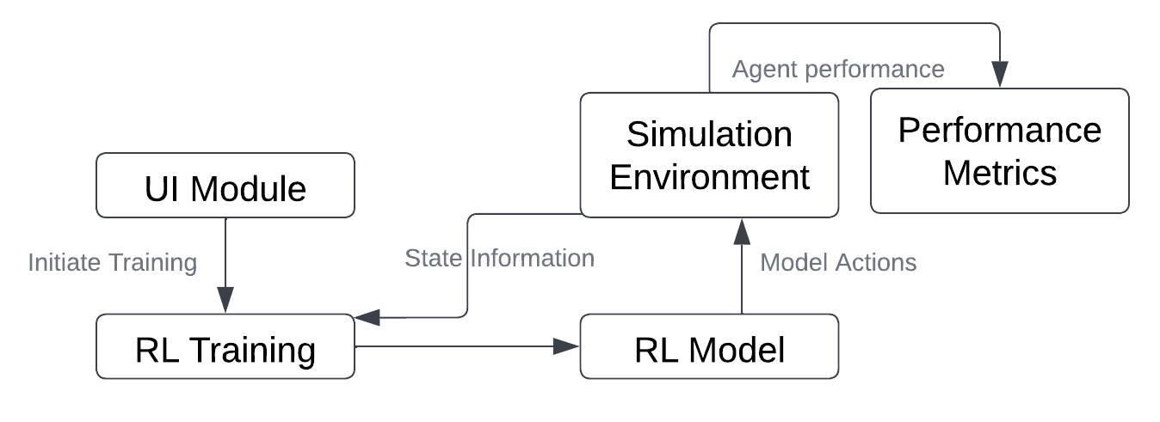
Interaction Between Components
Fig 3.2 Interaction between components
Notes:
[HIMANSHU]
Now lets see the functional specifications which are necessary for the actual functioning of the model
It requires an RL model with effective techniques for its training and implementation.
It also requires a wide variety of training data scenarios which will be provided by Unity Physics Engine.
Adaptability is also a core functional specification for the future use of the RL model.
The model should be able to have a good decision making capability making it a more secure and viable option.
Capability of measuring performance stats is also a functional specification.

Slide 17
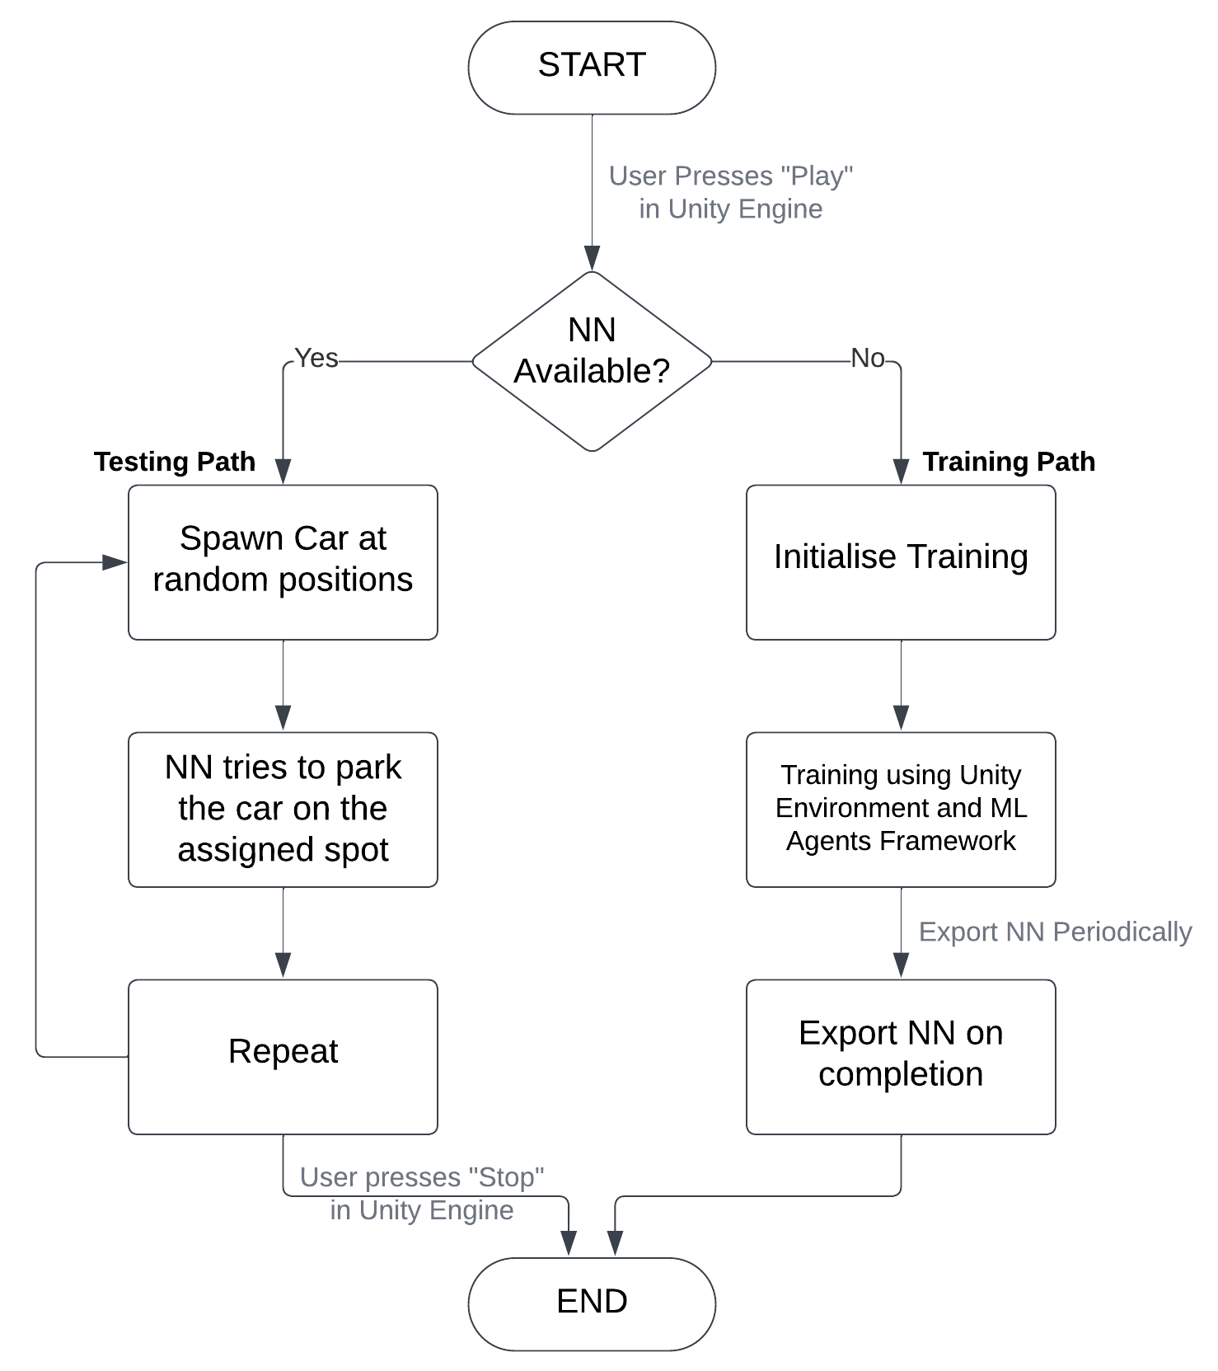
Data Flow
Fig 4.4 Data Flow Diagram
Notes:
[SHREYASHI]
Lets shed some light on these security requirements now,
The model should have data privacy and no one should be able to see or modify the model parameters or training data, it should also protect the user data associated with the model and its implementation.
The model must also implement access controls, restricting unauthorized access and actions.
Techniques will be implemented to maintain integrity of the model and improving the safety measures.
The data transmissions between various components should be secure and well protected to insure against threats and vulnerabilities.

Slide 18
Results
Notes:
[KUSHAGRA]

Slide 19
Results
Evaluation Tests: Conducted multiple tests to evaluate the efficiency and effectiveness of the parking agent.
Key Metrics:
Success Rate: The percentage of successful parking attempts.
Performance:
Efficiency ranged from 78.57% to 89.38%.
Highest efficiency model achieved 89.38%.

Slide 20
Results Contd.
Graphs & Analysis: Included detailed graphs and analysis to illustrate the agent's performance over time.
Note: For more details, refer to the report PDF file chapter 5.

Slide 21
Conclusion
Notes:
[KUSHAGRA]

Slide 22
Conclusion
Achievements: Successfully developed a robust RL-based autonomous parking system.
Future Enhancements:
Integration with Real-World Vehicles: Implementing the system in actual cars to test and improve real-world performance.
Advanced Driver Assistance Systems (ADAS): Enhancing the system to work in conjunction with ADAS for better safety and efficiency.
More Diverse Scenarios: Including more complex parking scenarios such as multi-level parking structures.
Emerging Technologies: Leveraging technologies like Vehicle-to-Infrastructure (V2I) communication for better decision-making.

Slide 23
Conclusion Contd.
Project Impact: Demonstrates significant advancements in autonomous parking technology.
Potential: Paves the way for safer, more efficient, and more convenient parking experiences.
Contributions: Adds to the body of knowledge in machine learning applications for autonomous vehicles.
Note: For more details, refer to the report PDF file chapter 6.

Slide 24
Demonstration
Video present on the pendrive.
Notes:
[KUSHAGRA]

Slide 25
References
Notes:
[KUSHAGRA]

Slide 26
References
Joy Zhang (2021). A hands-on introduction to deep reinforcement learning using Unity ML-Agents. Coder One. https://www.gocoder.one/blog/hands-on-introduction-to-deep-reinforcement-learning
Code Monkey (2021). Machine Learning AI in Unity (ML-Agents). YouTube. https://tinyurl.com/ykjpwqdk
U. T. (2022). Unity-Technologies/ml-agents. GitHub. https://github.com/Unity-Technologies/ml-agents
U. T. (2022). ML-Agents Toolkit Overview https://unity-technologies.github.io/ml-agents/ML-Agents-Overview/

Slide 27
References Contd.
Andres Leonardo Bayona (2023). Comparative Study of SAC and PPO in Multi-Agent Reinforcement Learning Using Unity ML-Agents (Universidad de los Andes). https://repositorio.uniandes.edu.co/server/api/core/bitstreams/cadff679-f3f3-43fa-a543-d6313c0a4932/content
Juliani, A., Berges, V.-P., Teng, E., Cohen, A., Harper, J., Elion, C., Goy, C., Gao, Y., Henry, H., Mattar, M., Lange, D. (2020). Unity: A General Platform for Intelligent Agents (arXiv:1809.02627). arXiv. http://arxiv.org/abs/1809.02627
Schulman, J., Wolski, F., Dhariwal, P., Radford, A., Klimov, O. (2017). Proximal Policy Optimization Algorithms (arXiv:1707.06347). arXiv. http://arxiv.org/abs/1707.0634735
ABL. (2023, May 30). PPO vs SAC [Video]. YouTube. https://www.youtube.com/watch?v=ZtdtpRmoFSE

Slide 28
References Contd.
Cobbe, K., Klimov, O., Hesse, C., Kim, T., and Schulman, J. (2019b). Quantifying generalization in reinforcement learning. (arXiv:1812.02341). arXiv. https://arxiv.org/abs/1812.02341
Lample, G. and Chaplot, D. S. (2017). Playing fps games with deep reinforcement learning. AAAI. https://ojs.aaai.org/index.php/AAAI/article/view/1082736
Note: For more details, refer to the references section of the report PDF file.

Slide 29
Thank You! Questions?
Notes:
Thanks a lot for hearing our project presentation and now you can ask all the questions you might have.

